Slide 1

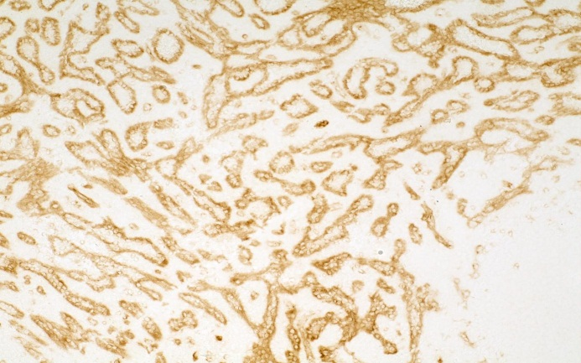
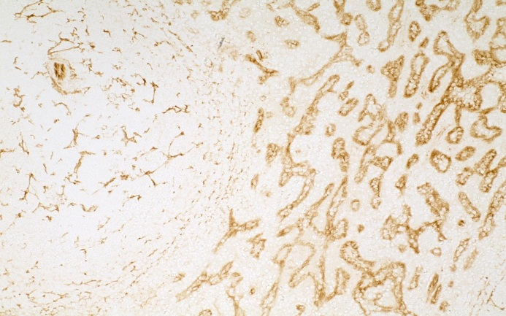
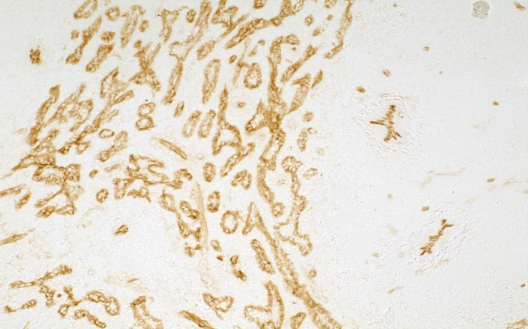
ReliaTech GmbH
Anti-human TIE-2
(Cat# 101-M50 / -M52 / -M54)
Human Spleen
Anti-human TIE-2 #tek2
Human Spleen
Anti-human TIE-2 #tek9
Human Spleen
Anti-human TIE-2 #tek16
The experiment was performed by Prof. Dr. Birte Steiniger, Institute of Anatomy and Cell Biology Robert-Koch-Str. 8, D-35037 Marburg, Germany
http://www.reliatech.de / orders@reliatech.de

